Slide 1

Segmentation Techniques:
Super Pixelization
& Region Growth
12.10.2024
Bret & Aiden
PHYS 510

Slide 2
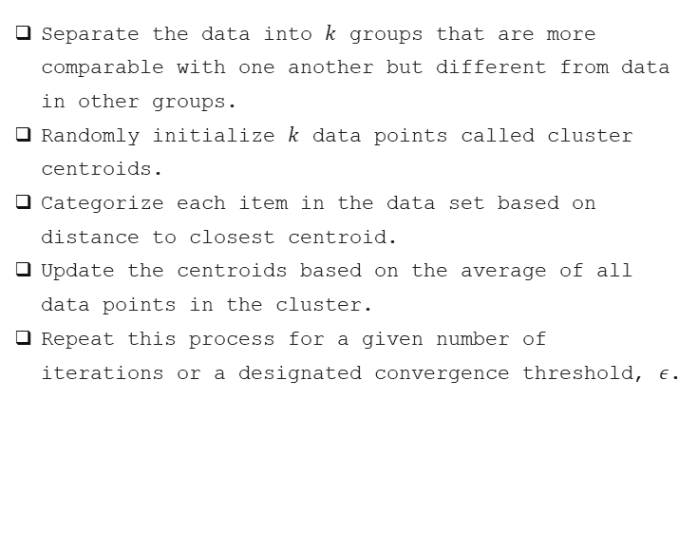
$k$-Means Clustering
Separate the data into $k$ groups that are more comparable with one another but different from data in other groups.
Randomly initialize $k$ data points called cluster centroids.
Categorize each item in the data set based on distance to closest centroid.
Update the centroids based on the average of all data points in the cluster.
Repeat this process for a given number of iterations or a designated convergence threshold, $ε$.
Sandipan Dey, 2023, https://sandipanweb.wordpress.com

Slide 3
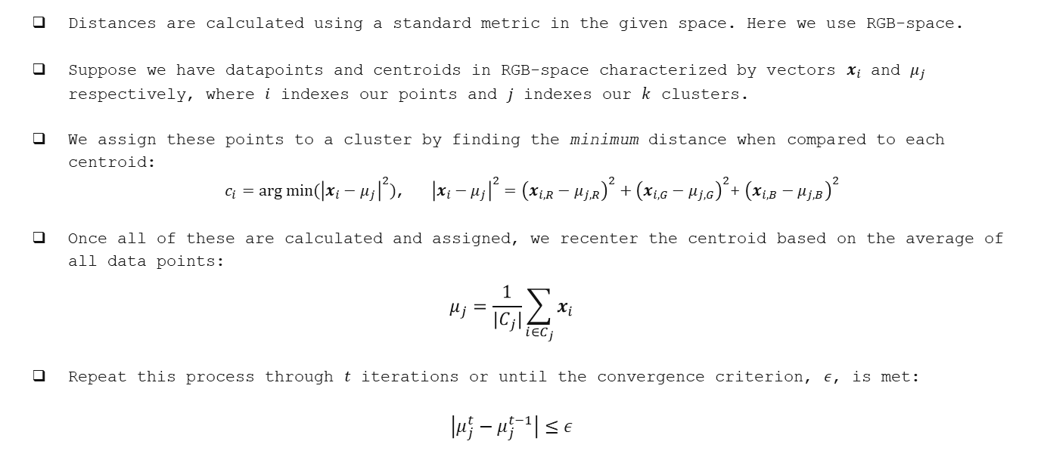
$k$-Means Clustering – ‘Distance’
Distances are calculated using a standard metric in the given space. Here we use RGB-space.
Suppose we have datapoints and centroids in RGB-space characterized by vectors $x_{i}$ and $μ_{j}$ respectively, where $i$ indexes our points and $j$ indexes our $k$ clusters.
We assign these points to a cluster by finding the minimum distance when compared to each centroid:
$c_{i}=arg min⁡({\left|x_{i}−μ_{j}\right|}^{2})$, ${\left|x_{i}−μ_{j}\right|}^{2}={\left(x_{i,R}−μ_{j,R}\right)}^{2}+{\left(x_{i,G}−μ_{j,G}\right)}^{2}$+ ${\left(x_{i,B}−μ_{j,B}\right)}^{2}$
Once all of these are calculated and assigned, we recenter the centroid based on the average of all data points:
$$μ_{j}=\frac{1}{{|C}_{j}|}\sum_{i∈C_{j}}{x_{i}}$$
Repeat this process through $t$ iterations or until the convergence criterion, $ε$, is met:
$$\left|μ_{j}^{t}−μ_{j}^{t−1}\right|≤ε$$

Slide 4
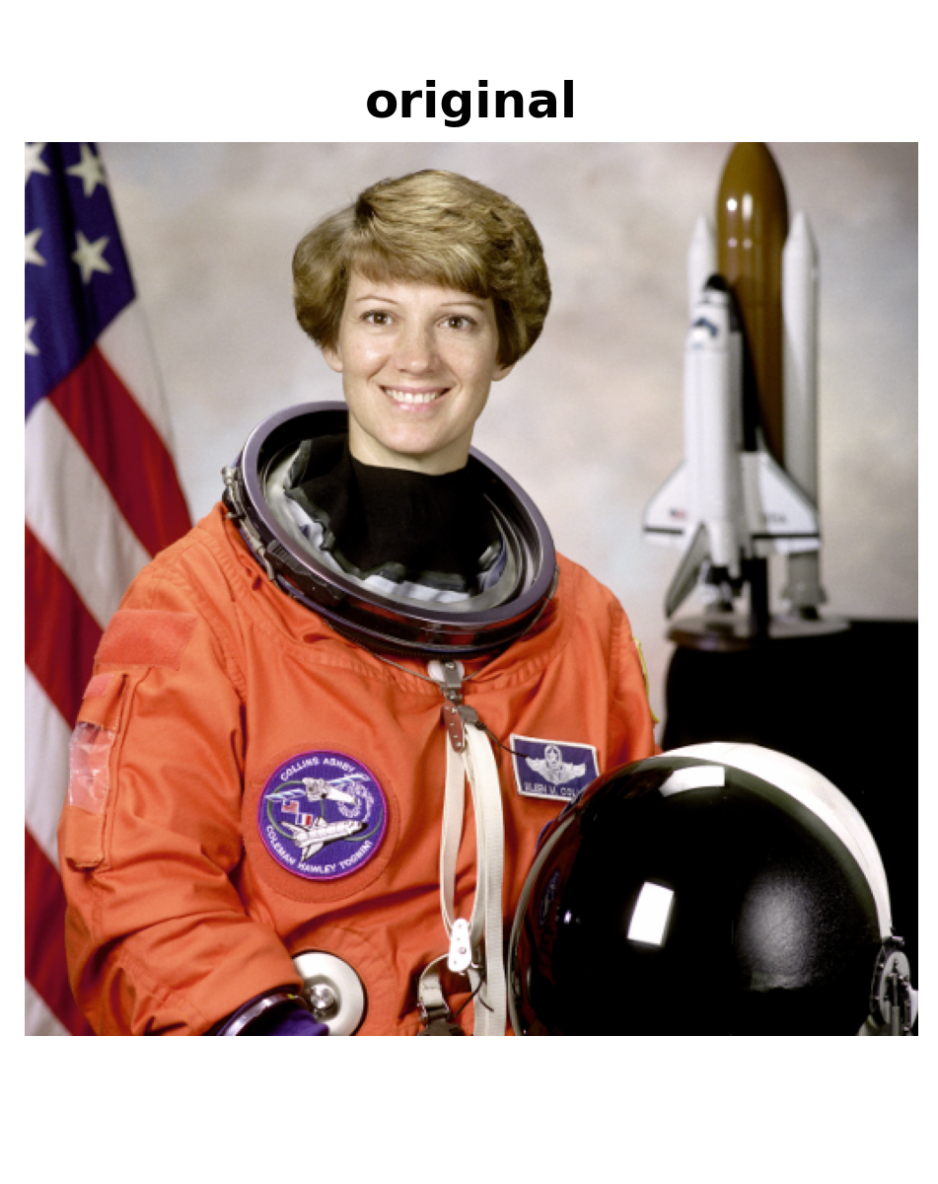
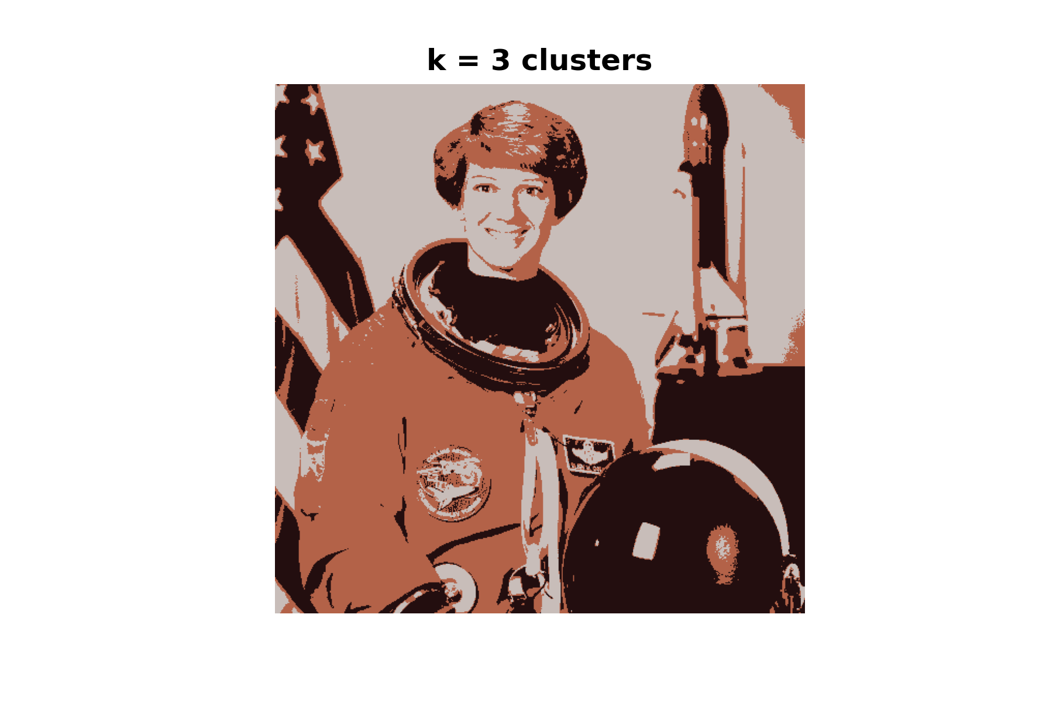
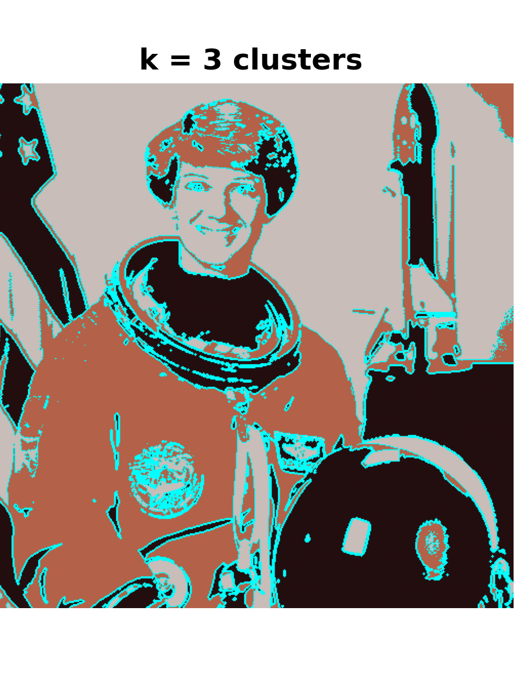
$k$-Means Clustering – Application

Slide 5
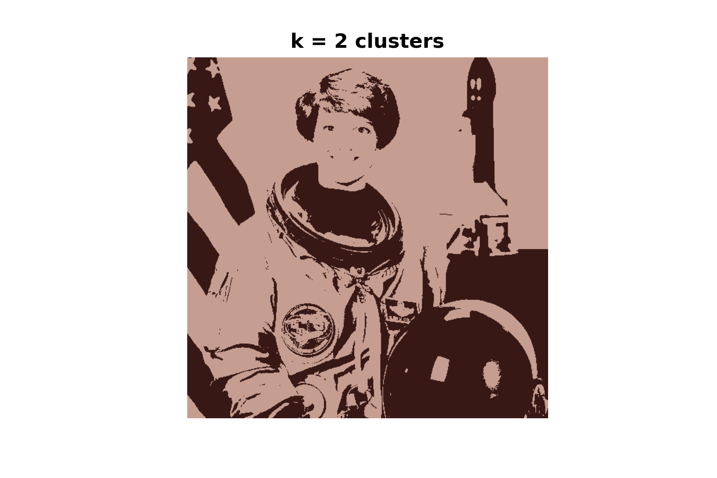
$k$-Means Clustering – Application

